Slide 1



AGE 214: Introduction to Electronics
Lecture 1: Intro & Semiconductor Physics
Sokoine University of Agriculture
AGE 214 - Lecture 1

Slide 2
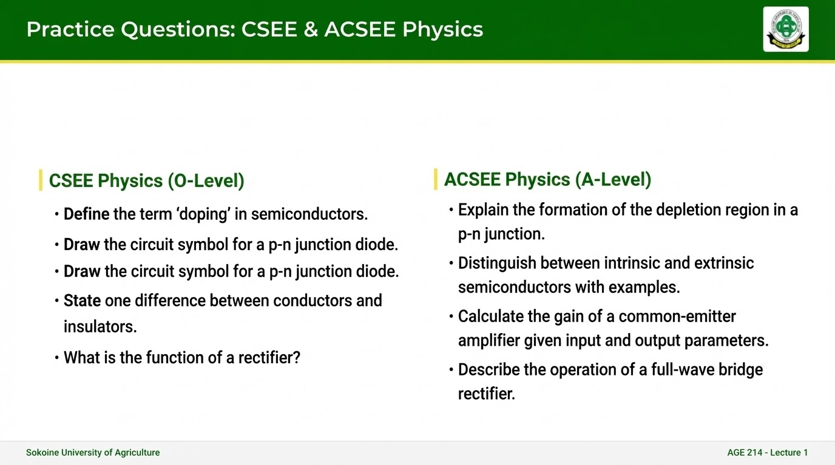

Slide 3

Course Overview
Welcome to AGE 214
This course bridges the gap between physics and practical engineering applications in agriculture.
Assessment Plan
•
Continuous Assessment: Quizzes & Labs (10%)
•
Goal: From atoms to amplifiers.
•
Mid-Semester Exam: Two Written Test (30%)
•
Focus: Understanding behavior of electronic devices.
•
Final Examination: Comprehensive (60%)
•
Application: Sensors, instrumentation, and control systems.
Sokoine University of Agriculture
AGE 214 - Lecture 1

Slide 4

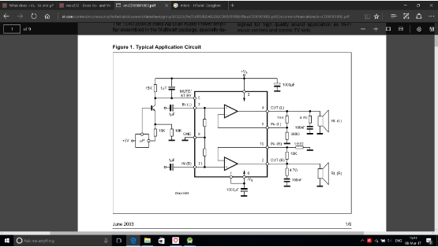
What is Electronics?
Definition
The branch of physics and engineering dealing with the emission, behavior, and effects of electrons, and with the use of electronic devices.
Electronics vs. Electrical Eng.
•
Electrical: High power, energy transfer (Motors, Grid).
•
Electronics: Low power, information processing (Chips, Sensors).
Sokoine University of Agriculture
AGE 214 - Lecture 1

Slide 5
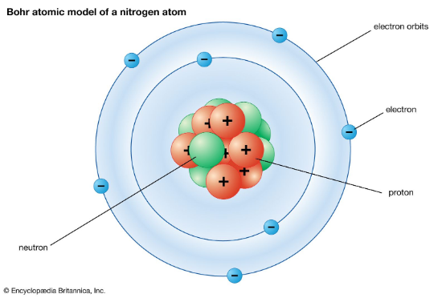

Structure of Matter: The Bohr Model
The Planetary Model
Atoms consist of a central nucleus (Protons + Neutrons) surrounded by orbiting Electrons in specific energy shells.
Shell Capacity Formula
Where n is the shell number (1, 2, 3...).
Sokoine University of Agriculture
AGE 214 - Lecture 1

Slide 6







Valence Electrons & Energy Levels
Valence Electrons
Ionization
Electron Volt (eV)
Electrons in the outermost shell. They determine the chemical properties and electrical conductivity of the material.
Positive Ion: Atom loses valence electron.
Negative Ion: Atom gains valence electron.
Unit of energy in electronics. Energy gained by an electron moving through 1 Volt potential.
Sokoine University of Agriculture
AGE 214 - Lecture 1

Slide 7

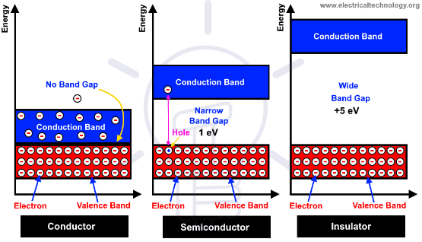
Energy Band Theory
Key Concepts
•
Valence Band: Range of energies for bound valence electrons.
•
Conduction Band: Higher energy range where electrons are free to move (current flow).
•
Forbidden Gap (Eg): Energy gap between bands. No electrons exist here.
The size of the gap determines if a material is a conductor, insulator, or semiconductor.
Sokoine University of Agriculture
AGE 214 - Lecture 1

Slide 8
Classifying Materials
Material | Band Gap (Eg) | Characteristics | Examples
Insulator | Large (> 5 eV) | Electrons tightly bound. No flow. | Glass, Rubber, Wood
Conductor | Zero (Overlap) | Bands overlap. Electrons flow freely. | Copper, Gold, Silver
Semiconductor | Small (~ 1 eV) | Conducts under right conditions. | Silicon, Germanium
Sokoine University of Agriculture
AGE 214 - Lecture 1

Slide 9
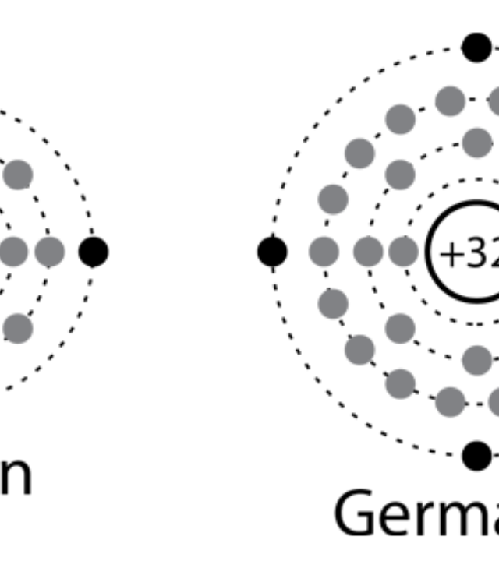
Silicon vs. Germanium
Silicon (Si): Atomic Number 14. 4 Valence electrons. Most abundant and thermally stable. Eg = 1.1 eV.
Germanium (Ge): Atomic Number 32. 4 Valence electrons. Less stable (sensitive to heat). Eg = 0.67 eV.
Both are Tetravalent atoms, meaning they have 4 electrons in the outer shell, key for forming crystal lattices.

Slide 10
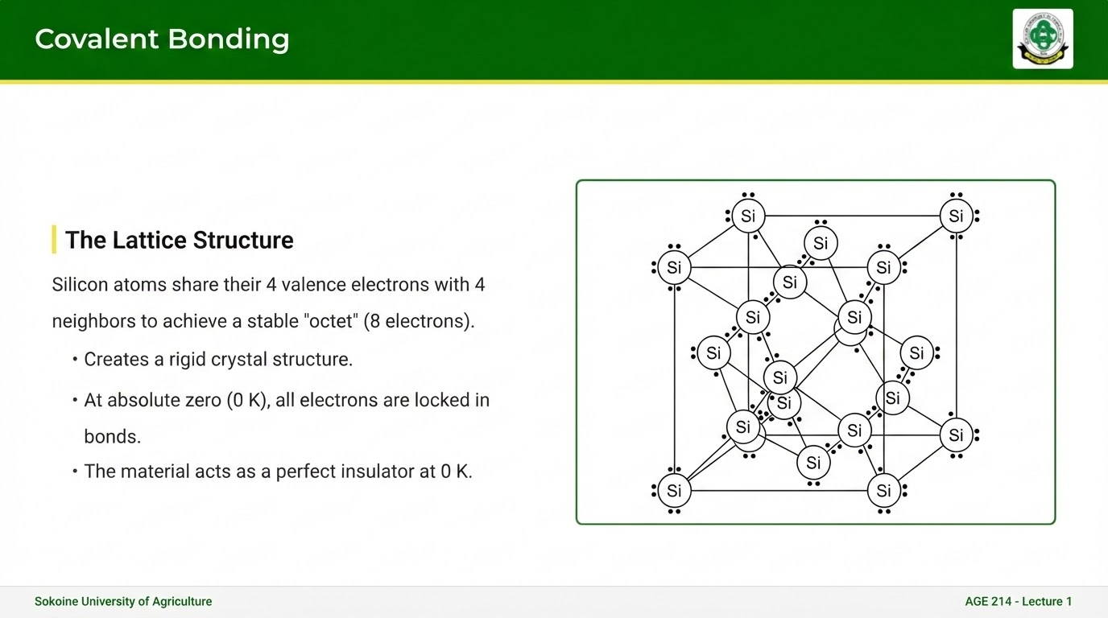

Slide 11
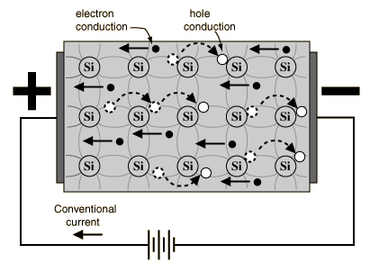
Current Flow Mechanisms
Two Types of Current
When thermal energy breaks a bond:
1.
Free Electron: Moves in Conduction Band.
2.
Hole: The vacancy left behind in the Valence Band.
Electron Current: Physical movement of electrons.
Hole Current: Effective movement of positive charge (vacancies) in the opposite direction.
Sokoine University of Agriculture
AGE 214 - Lecture 1

Slide 12


Intrinsic Semiconductors
Definition
Carrier Concentration
A pure semiconductor with no impurities added (e.g., Pure Silicon).
The number of free electrons (n) exactly equals the number of holes (p).
ni is the intrinsic carrier concentration.
Next Lecture: How we change conductivity by adding impurities (Doping).
Sokoine University of Agriculture
AGE 214 - Lecture 1

Slide 13
Questions?
See you in the next class.
Dr. Kadeghe Fue
Sokoine University of Agriculture
AGE 214 - Lecture 1

